Slide 1
Gaussian fitting

Slide 2
The algorithm
get the baseline of the dataset - the average of the first and last 10 numbers - and subtract it from the dataset
compute the initial integral (∫│y│dx of the dataset)
fit individual Gaussians one-by-one
find the maximum of the dataset
obtain rough estimates for a Gaussian fit with its peak in that point
use an external solver to optimize these parameters
store the Gaussian if it is big enough and subtract it from the dataset
repeat until the ratio of the current dataset integral to the initial dataset integral gets below a certain threshold or until the maximal number of iterations is reached
group the Gaussians based on overlapping concavity intervals into peaks

Slide 3
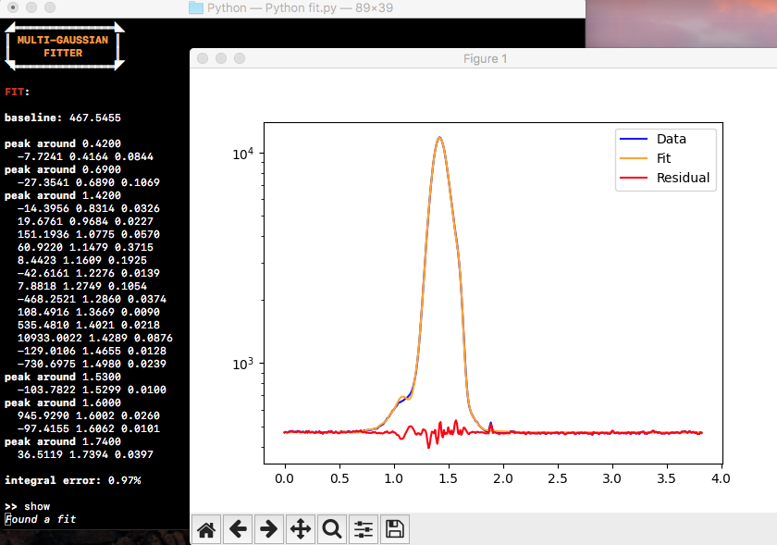
The tool
basic functionality:
loading a dataset from a file
computing a fit with variable parameters
displaying the fit and plotting it through an interactive graphical interface

Slide 4
Known limitations
0.28% is a precise as it can get for now, this could potentially be improved with a better initial guess
previous functionality included entering data by directly pasting it into the terminal, but on most devices this would corrupt entries, making parameter prediction very inaccurate and thus severely increasing error, so this mode is currently not present

